Slide 1




第三届中国Rust开发者大会

Slide 2

THE FIRST EXPLORATION OF PROJECT SPARROW
Feng Li (李枫)
hkli2013@126.com
Jun 18, 2023

Slide 3
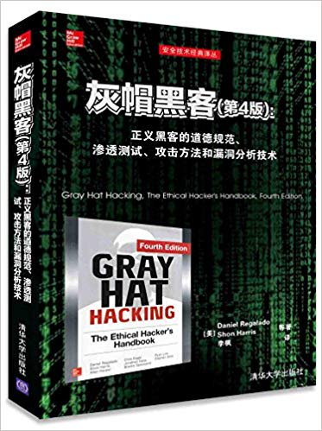
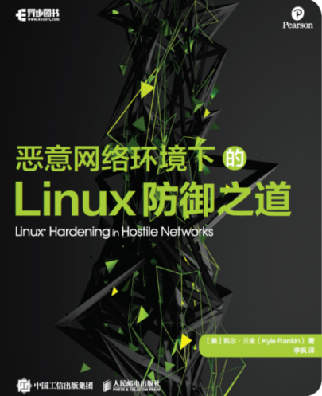
Who Am I
An indie developer from China
The main translator of the book «Gray Hat
Hacking The Ethical Hacker's Handbook,
Fourth Edition» (ISBN：9787302428671)
& «Linux Hardening in Hostile Networks,
First Edition» (ISBN: 9787115544384)
Pure software developmement for ~15
years(~11 years on Mobile dev)
Actively participating Open Source
Communities:
https://github.com/XianBeiTuoBaFeng2015/MySlides
Recently, focus on infrastructure of
Cloud/Edge Computing, AI, IoT,
Programming Languages & Runtimes,
Network, Virtualization, RISC-V, EDA,
5G/6G…

Slide 4
Agenda
I. Background
Tech Stack
Project Sparrow
Testbed
II. Practicing Sparrow
CantripOS(KataOS)
Rust support in seL4 userspace
III. Sparrow development
Develop with Renode
IV. Wrap-up

Slide 5
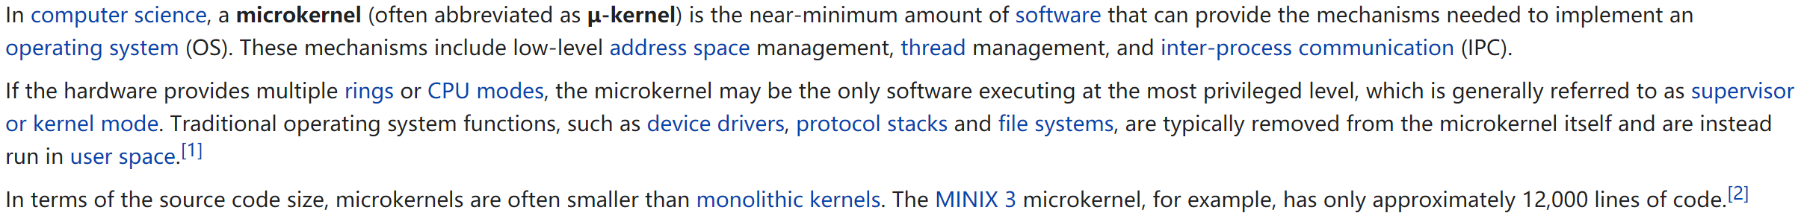
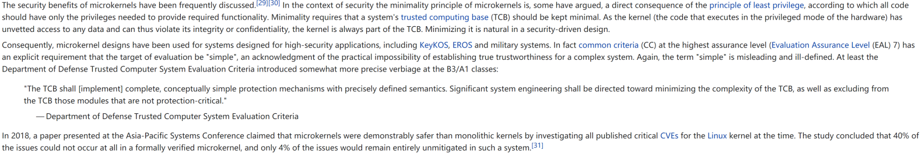
I. Background
1) Tech Stack
1.1 Microkernel
Overview
https://en.wikipedia.org/wiki/Microkernel
Security

Slide 6
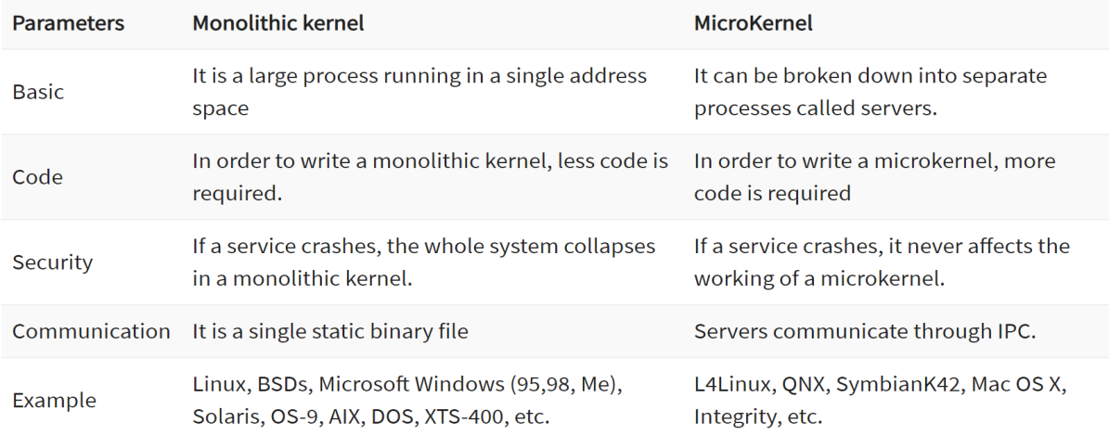
I. Background
Difference Between Microkernel and Monolithic Kernel:
Source: https://www.guru99.com/microkernel-in-operating-systems.html

Slide 7
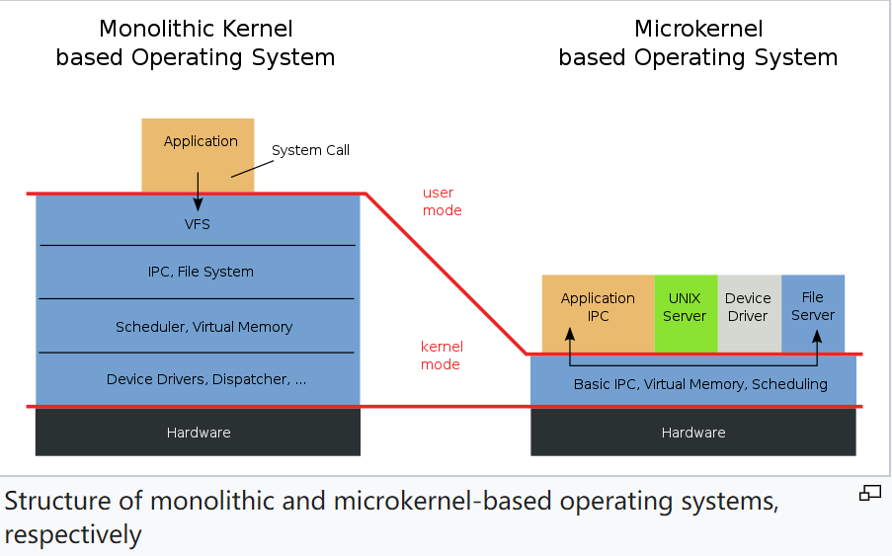
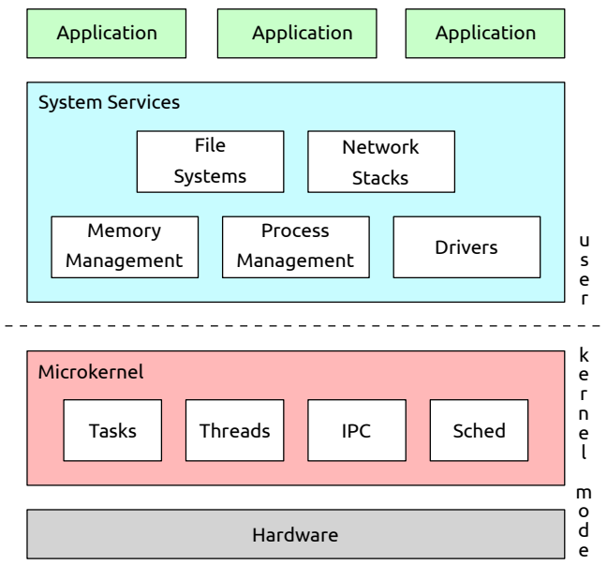
I. Background
Architecture & Design
.
Source: https://os.inf.tu-dresden.de/Studium/MkK//SS2021/01_intro.pdf

Slide 8
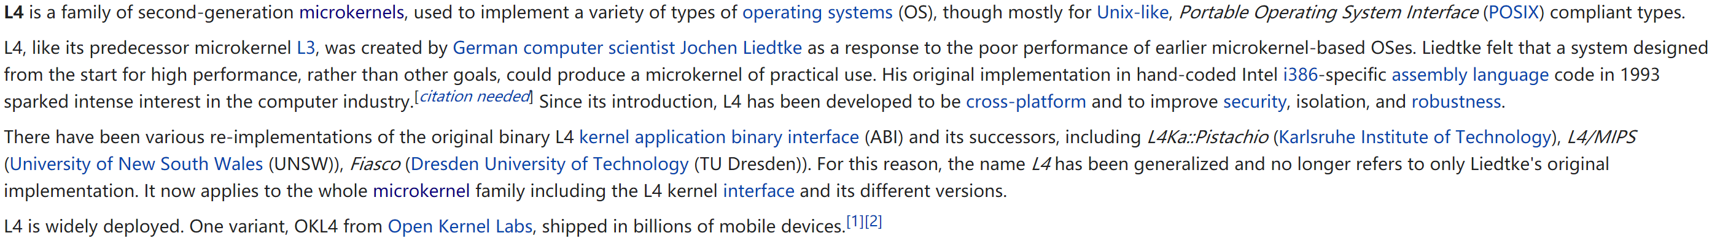
I. Background
1.2 L4
Overview
https://en.wikipedia.org/wiki/L4_microkernel_family

Slide 9
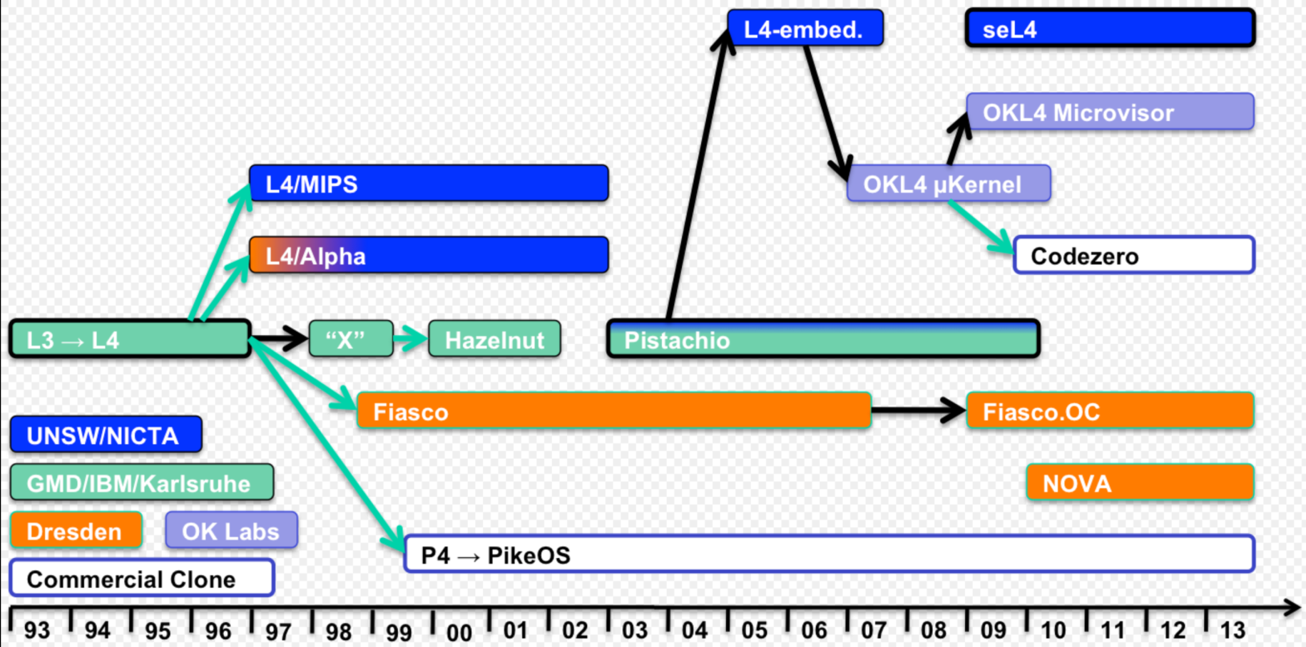
I. Background
L4 family tree:

Slide 10
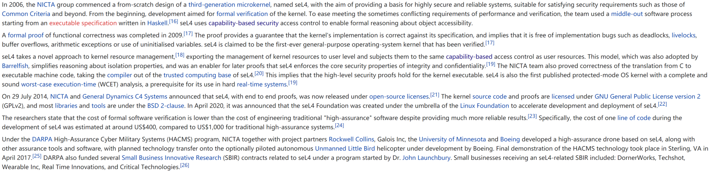
I. Background
1.2.1 seL4
Overview
https://en.wikipedia.org/wiki/L4_microkernel_family#High_assurance:_seL4
https://sel4.systems

Slide 11
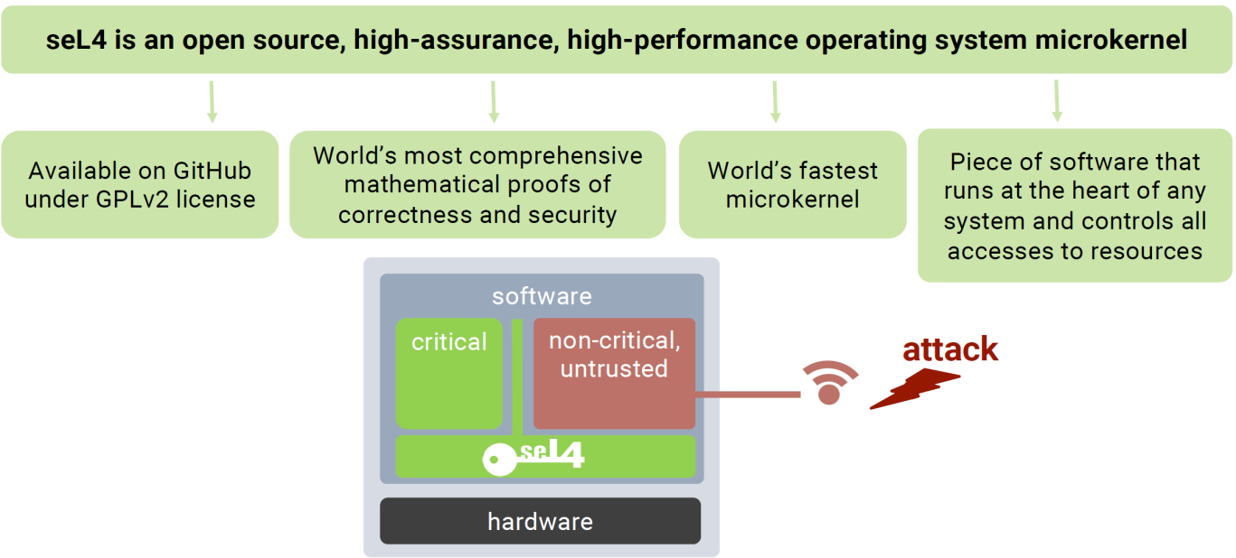
I. Background
.
Source: “The seL4 Report”, Gernot Heiser, Fosdem 2021.

Slide 12

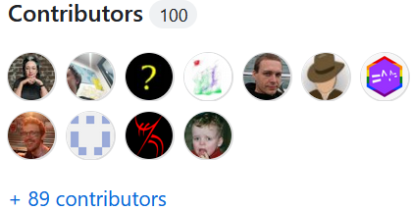
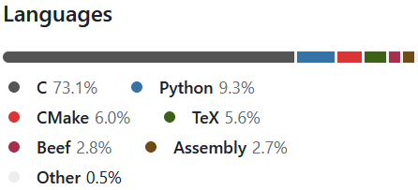
I. Background
Src

Slide 13
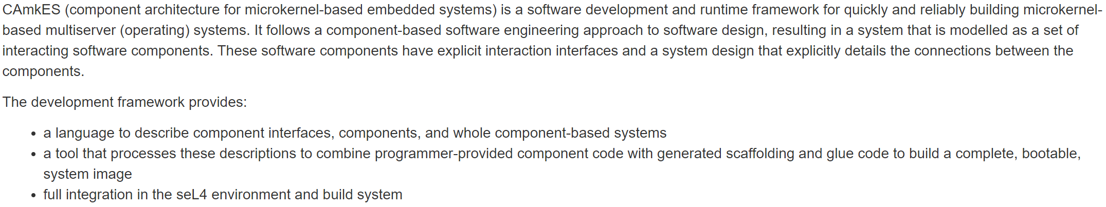
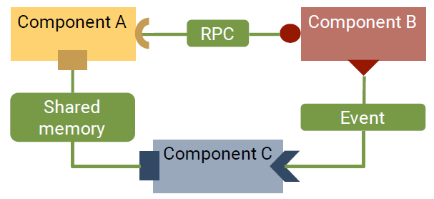
I. Background
1.2.1.1 CAmkES
https://docs.sel4.systems/projects/camkes/
https://github.com/seL4/camkes
https://github.com/seL4/camkes-vm
CAmkES ADL
Source: https://sel4.systems/About/seL4-whitepaper.pdf

Slide 14
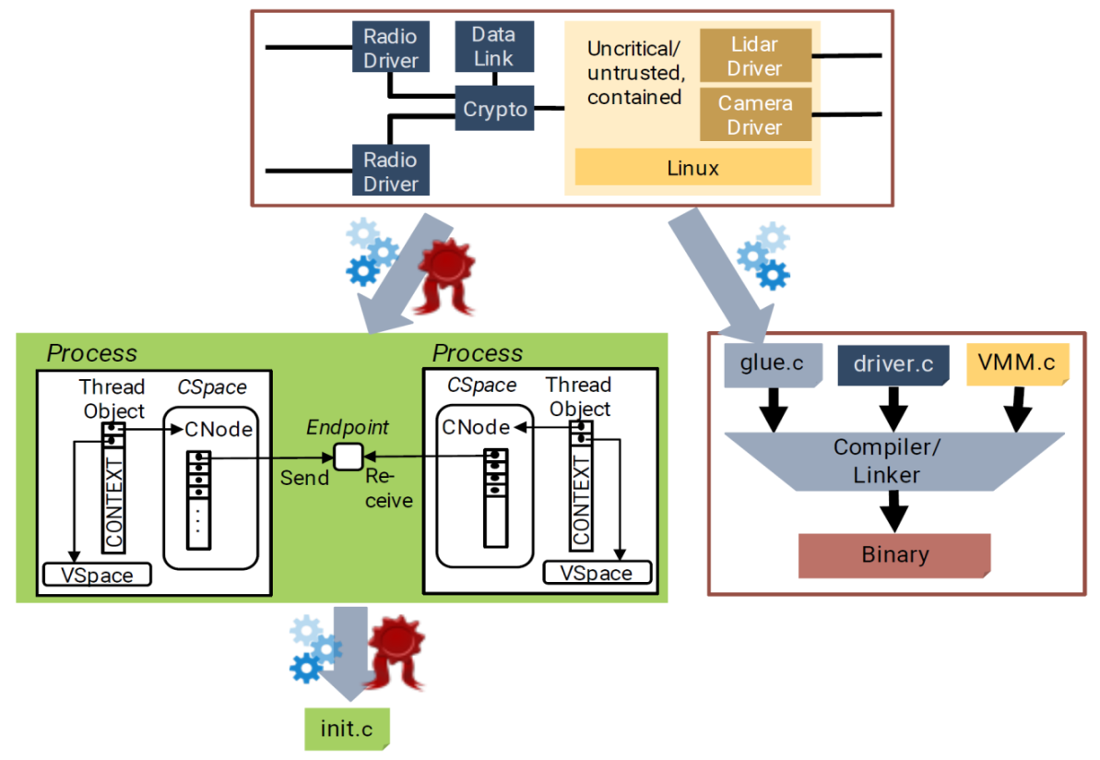
I. Background
Source: https://sel4.systems/About/seL4-whitepaper.pdf

Slide 15
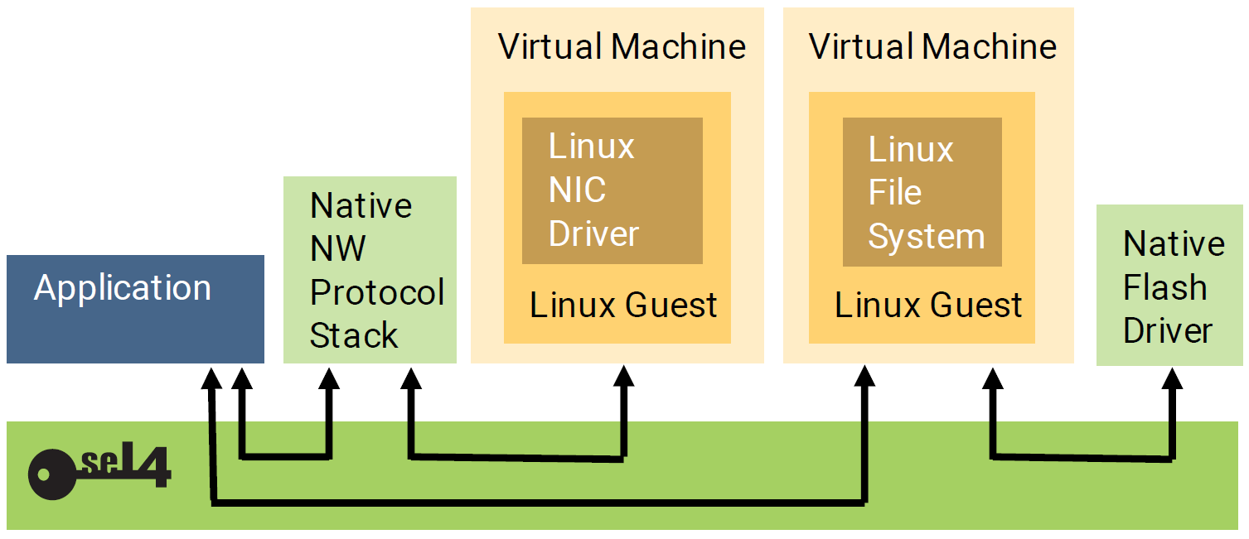
I. Background
1.2.1.2 Virtualization
seL4 is also a hypervisor
Source: https://sel4.systems/About/seL4-whitepaper.pdf

Slide 16
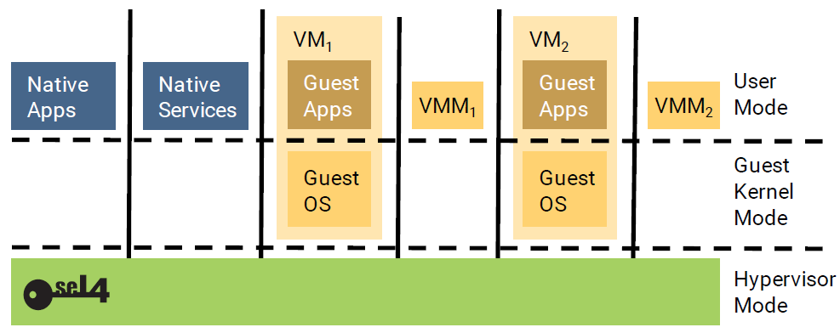
I. Background
seL4 virtualization support with usermode VMMs
Source: https://sel4.systems/About/seL4-whitepaper.pdf

Slide 17
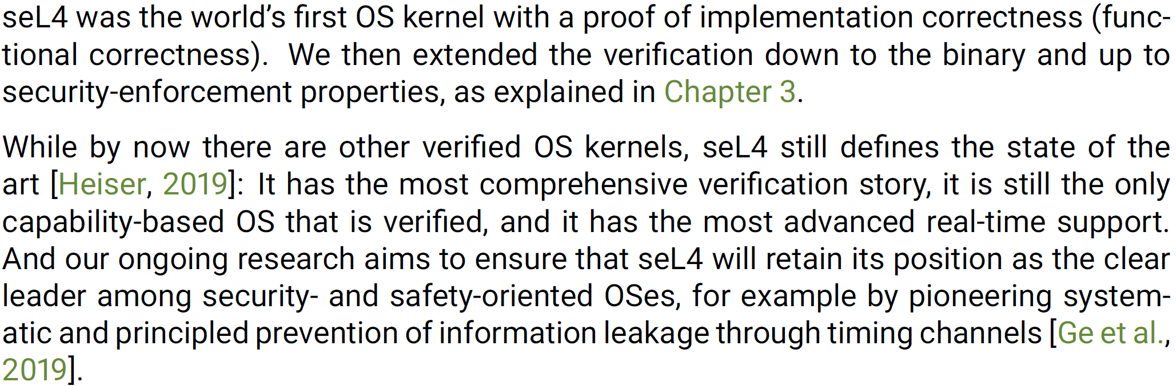
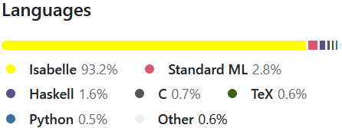
I. Background
1.2.1.3 Provable Security
.
https://docs.sel4.systems/projects/l4v/
https://github.com/seL4/l4v
Source: https://sel4.systems/About/seL4-whitepaper.pdf

Slide 18
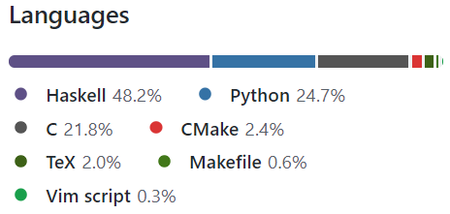
I. Background
CapDL
Capability Distribution Language tools for seL4
https://github.com/seL4/capdl

Slide 19
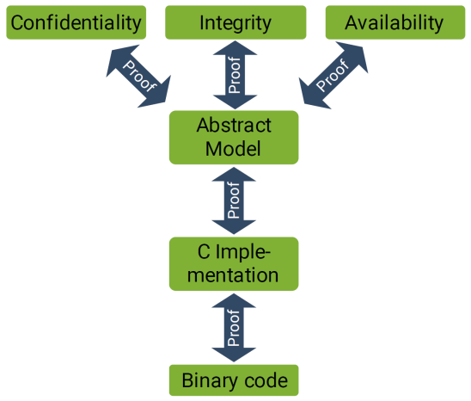
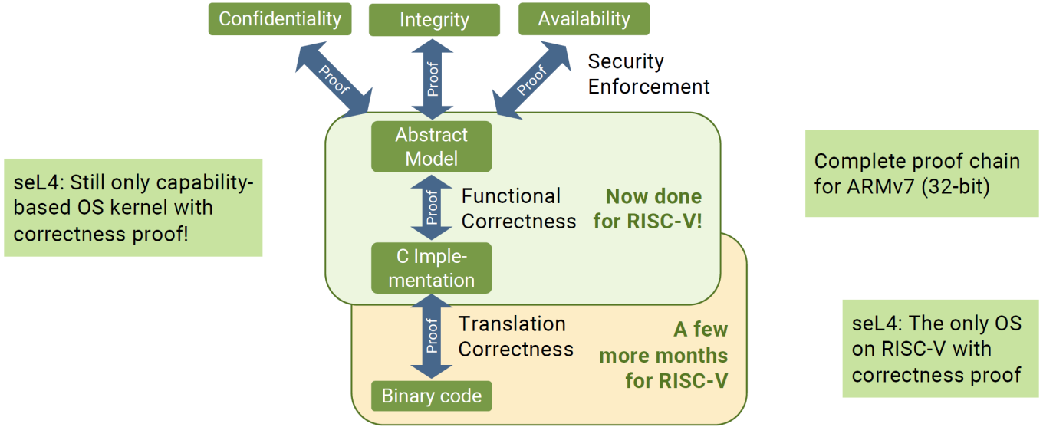
I. Background
Mathematical Proof
https://sel4.systems/Info/FAQ/proof.pml
seL4’s proof toolchain Status
https://docs.sel4.systems/projects/sel4/status.html
Source: https://sel4.systems/About/seL4-whitepaper.pdf

Slide 20
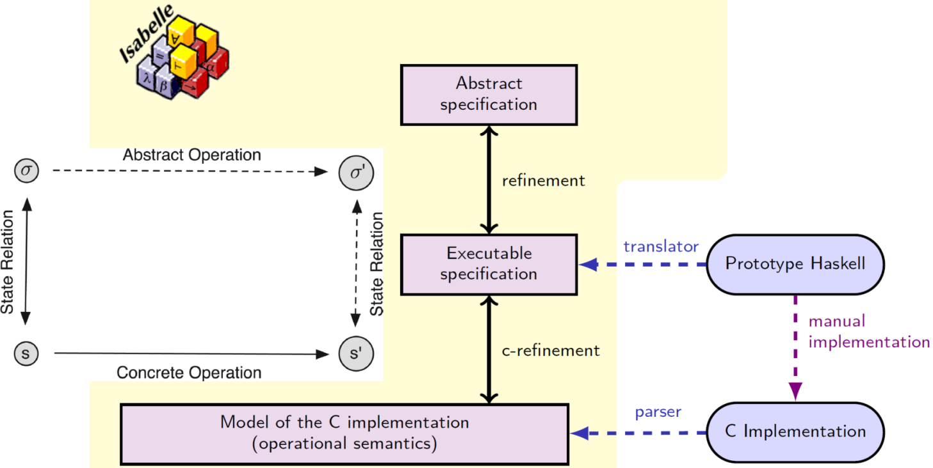
I. Background
Functional correctness
e.g.:
Source: https://www.tbrk.org/

Slide 21
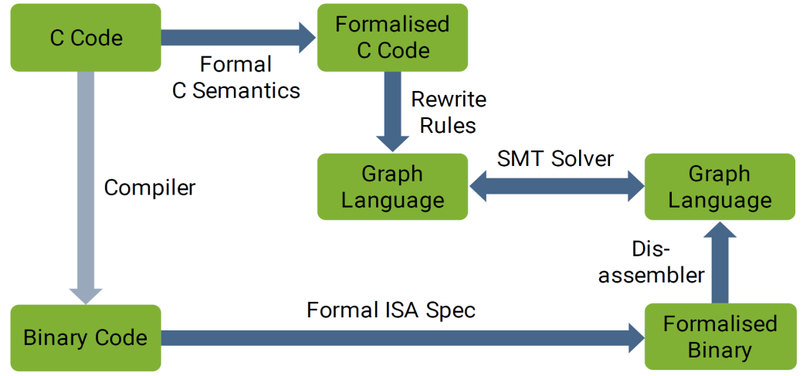
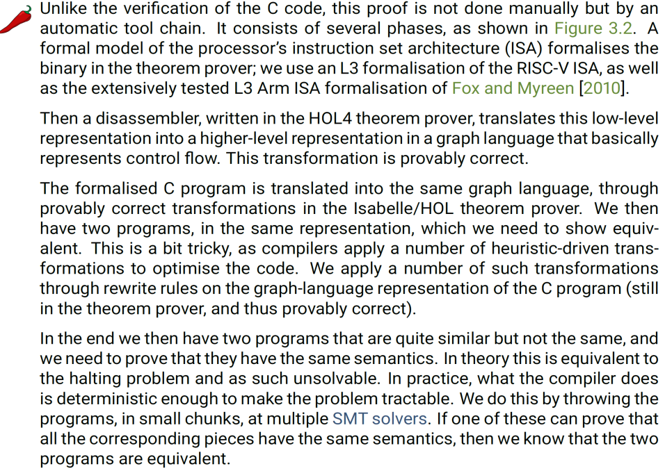
I. Background
Translation validation
Source: https://sel4.systems/About/seL4-whitepaper.pdf

Slide 22
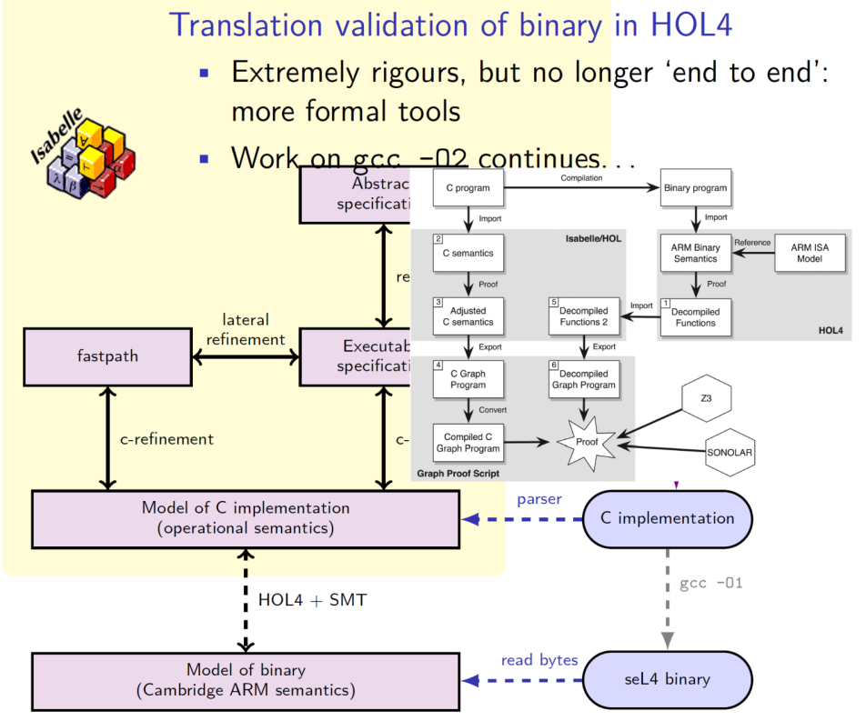
I. Background
e.g.:
Source: https://www.tbrk.org/

Slide 23
I. Background
1.3 FOSS EDA
Overview
https://en.wikipedia.org/wiki/Comparison_of_EDA_software
https://semiwiki.com/wikis/industry-wikis/eda-open-source-tools-wiki/
https://fossi-foundation.org/
https://ieeexplore.ieee.org/document/9398963
https://ieeexplore.ieee.org/document/9398960
https://ieeexplore.ieee.org/document/9336682
https://ieeexplore.ieee.org/document/9105619
…
https://sel4.systems

Slide 24
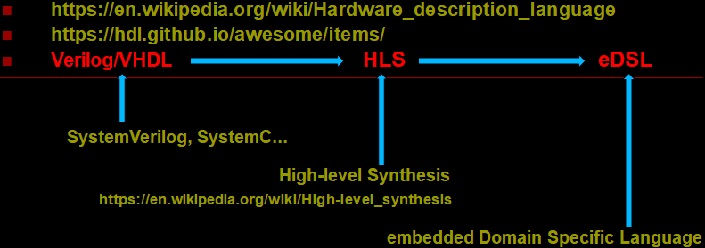
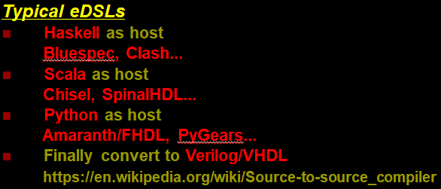
I. Background
1.3.1 Evolution of HDLs

Slide 25
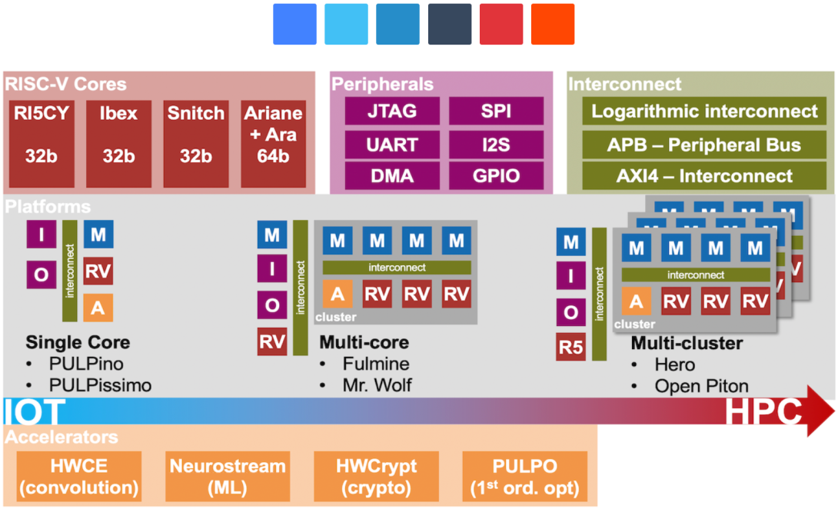
I. Background
1.4 RISC-V
https://en.wikipedia.org/wiki/RISC-V
https://riscv.org/
Development
https://riscv.org/exchange/
https://github.com/riscv/riscv-isa-manual
Cores & SoC
https://github.com/riscv/riscv-cores-list
https://riscv.org/exchange/cores-socs/
Source: https://fuentitech.com/what-is-the-risc-v-ecosystem/19227/

Slide 26
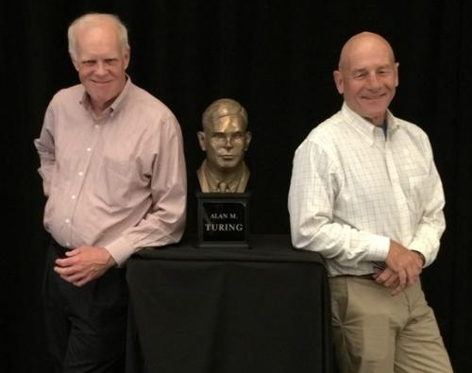
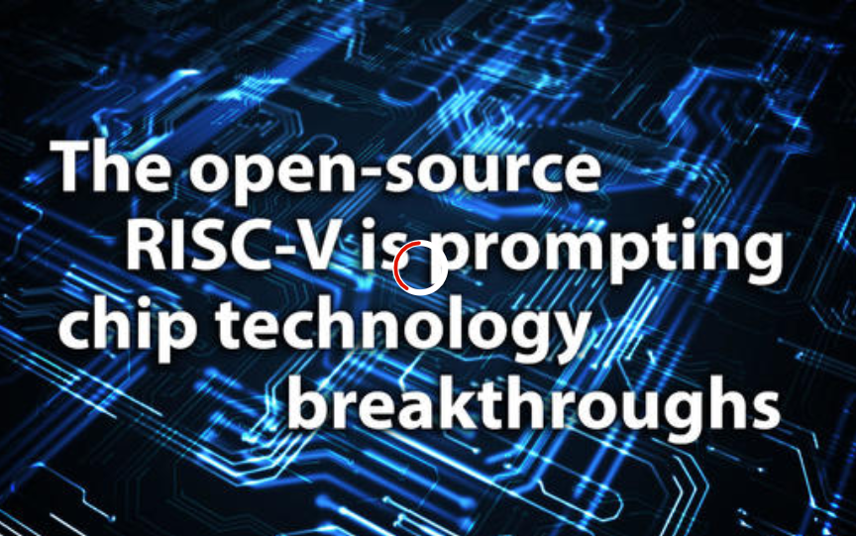
I. Background
1.4.1 Ecosystem
https://community.riscv.org/events/details/risc-v-foundation-bay-area-risc-v-group-presents-2021-risc-
v-ecosystem-updates/
Source: https://cacm.acm.org/magazines/2019/2/234352-a-
new-golden-age-for-computer-architecture/fulltext
Source: https://www.zdnet.com/article/risc-v-the-linux-of-the-chip-world-is-starting-to-produce-technological-breakthroughs/

Slide 27
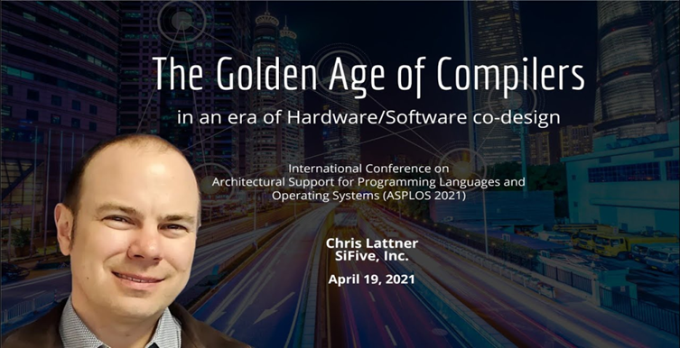
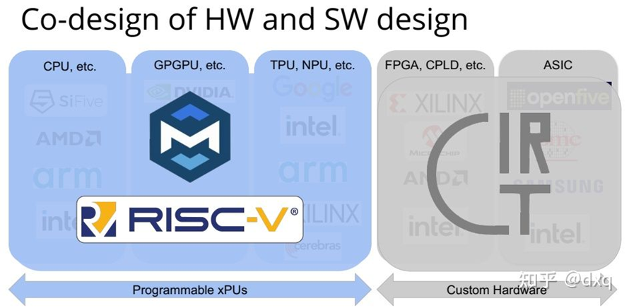
I. Background
Source: https://zhuanlan.zhihu.com/p/367035973

Slide 28
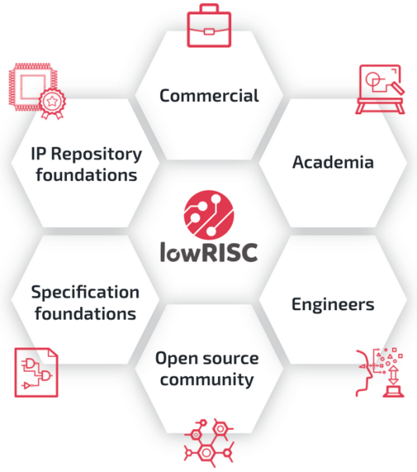
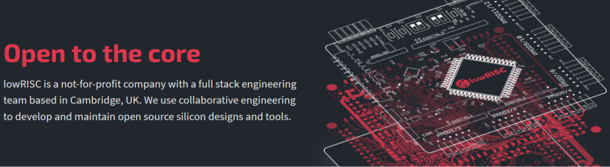
I. Background
1.4.2 lowRISC
Overview
https://lowrisc.org/
https://github.com/lowrisc

Slide 29
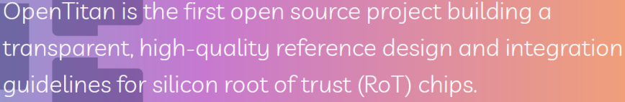
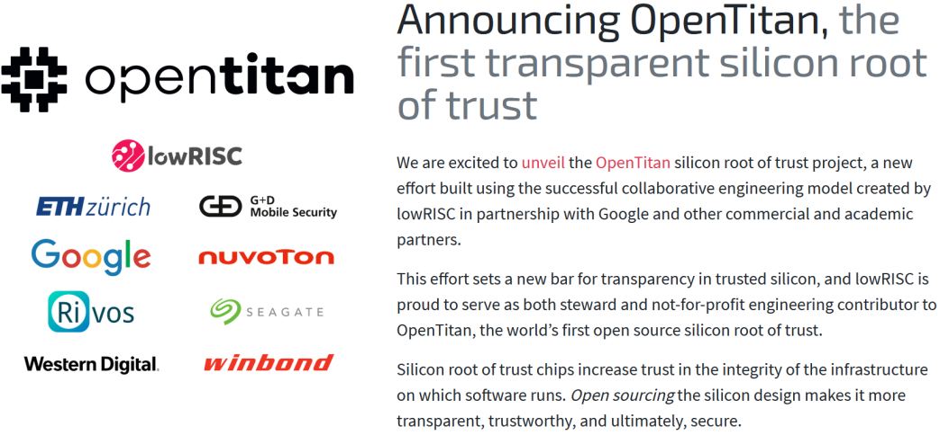
I. Background
1.4.2.1 Project OpenTitan
Overview
https://opentitan.org/
.
Source: https://lowrisc.org

Slide 30
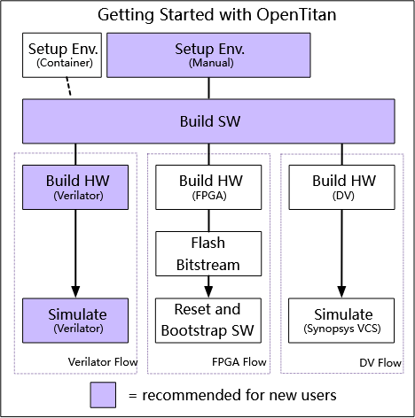
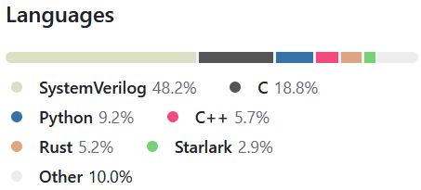
I. Background
https://github.com/lowRISC/opentitan
Workflow
Source: https://opentitan.org/guides/getting_started/index.html

Slide 31

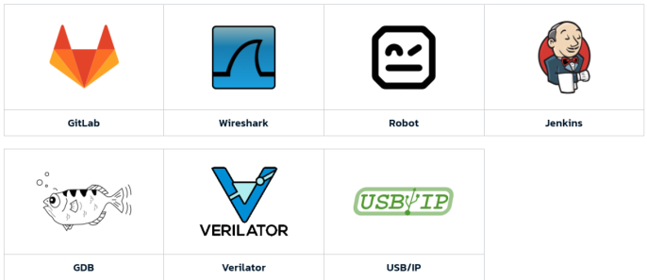

I. Background
1.5 Renode
Overview
https://renode.io/
Antmicro's virtual development framework for complex embedded systems.
https://github.com/lowrisc

Slide 32
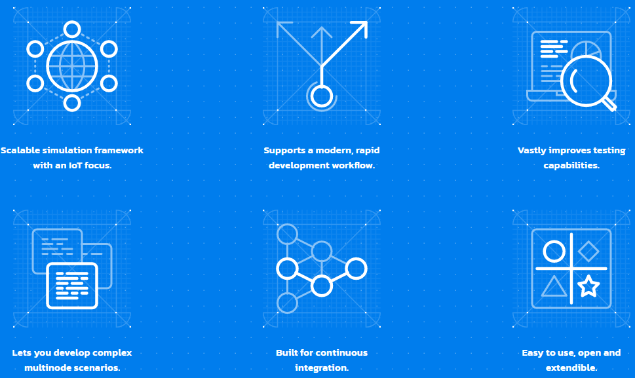
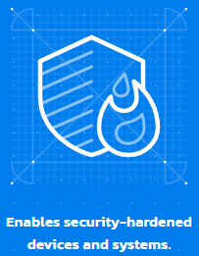
I. Background
Key features:
https://renode.io/about/

Slide 33
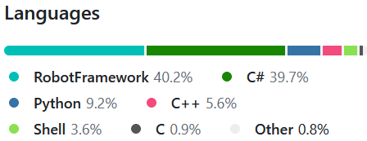
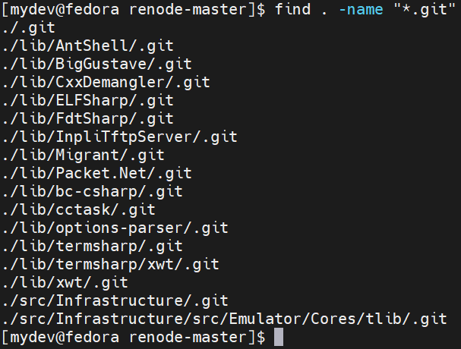
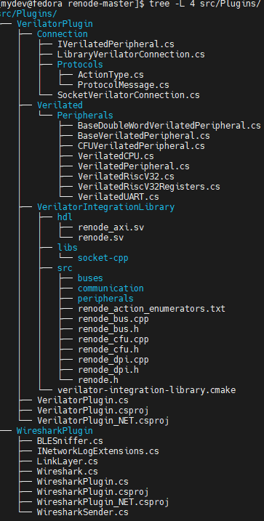
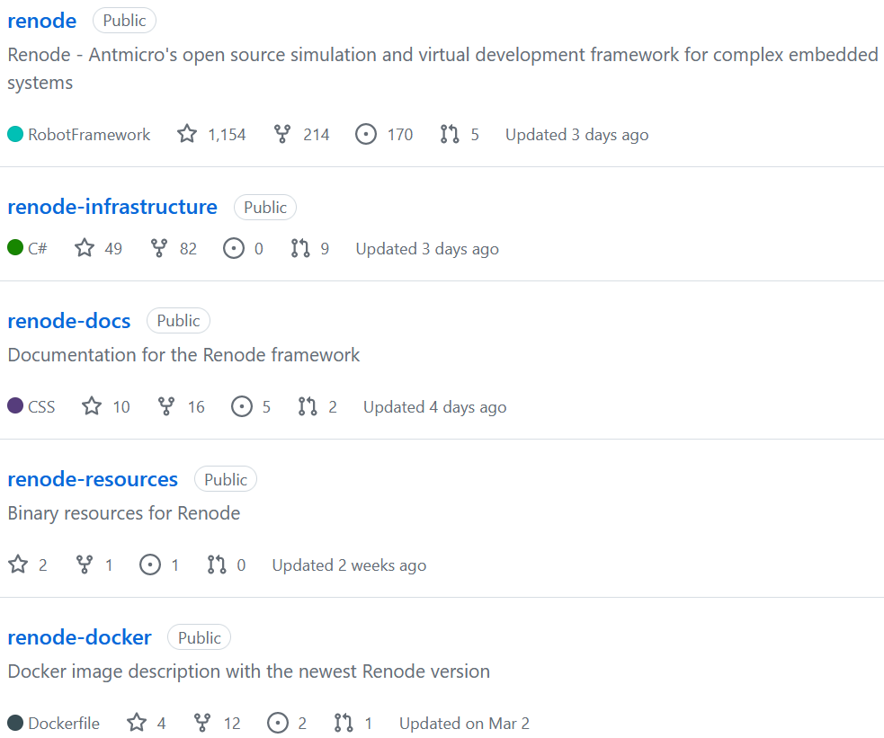
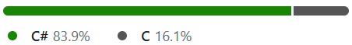
I. Background
1.5.1 Src
https://github.com/renode
https://github.com/antmicro/tlib

Slide 34
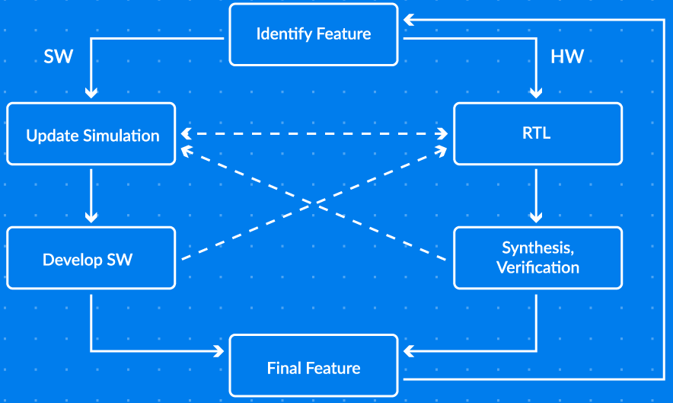
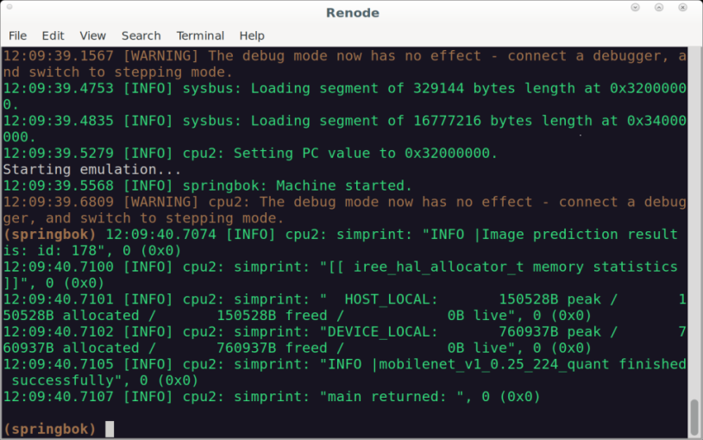
I. Background
1.5.2 Co-simulating by Renode
Source: https://opensource.googleblog.com/2022/09/co-simulating-ml-with-springbok-using-renode.html

Slide 35


I. Background
1.5.3 Renode for RISC-V development
Official
https://riscv.org/announcements/2021/12/risc-v-celebrates-incredible-year-of-growth-and-progress-ratifying-multiple-
technical-specifications-launching-new-education-programs-and-accelerating-broad-industry-adoption/
https://riscv.org/blog/2021/06/antmicro-open-source-portal-launched/
https://riscv.org/blog/2021/03/bringing-the-benefits-of-risc-v-and-renode-to-the-very-efficient-deep-learning-in-iot-project/
…

Slide 36


I. Background
2) Project Sparrow
2.1 Overview
https://renohttps://github.com/AmbiML/sparrow-manifest

Slide 37

I. Background
Software repositories:

Slide 38


I. Background
2.2 CantripOS(KataOS)
Overview
https://github.com/AmbiML/sparrow-cantrip-full

Slide 39


I. Background
Rust crates
.
Source: https://github.com/AmbiML/sparrow-manifest

Slide 40




I. Background
3) Testbed
3.1 Intel NUC X15 LAPAC71H(32GB DDR5) with Fedora 38
HW
http://www.intel.com/AC57-Support
SW

Slide 41





I. Background

Slide 42


I. Background
3.2 Raspberry Pi
RPi4 (8GB LPDDR4) with Fedora 37
HW
SW

Slide 43

I. Background
RPi3 B+ (1G LPDDR2)
https://www.raspberrypi.com/products/raspberry-pi-3-model-b-plus/
HW
SW

Slide 44


II. Practicing Sparrow
1) CantripOS(KataOS)
1.1 Getting started
https://github.com/AmbiML/sparrow-cantrip-full/blob/main/docs/GettingStarted.md

Slide 45


II. Practicing Sparrow
1.1.1 Testing on LAPAC71H
repo
procedure:
…

Slide 46


II. Practicing Sparrow

Slide 47

II. Practicing Sparrow
2) Rust support in seL4 userspace
Overview
A good summary from "Rust support in seL4 userspace：Present and future", Nick Spinale,
seL4 Summit 2022:

Slide 48


II. Practicing Sparrow
2.1 Rust-centric Pop!_OS
2.1.1 Rust-Written Desktop
https://www.phoronix.com/scan.php?page=news_item&px=Pop-OS-New-Rust-Desktop
Source: https://news.itsfoss.com/system76-rust-cosmic-desktop/

Slide 49


II. Practicing Sparrow
2.1.2 System76-Scheduler
https://github.com/pop-os/system76-scheduler
Auto-configure CFS and process priorities for improved desktop responsiveness.
https://www.phoronix.com/scan.php?page=news_item&px=System76-Scheduler-1.1

Slide 50


II. Practicing Sparrow
2.2 Rust for Cloud Native
https://rust-cloud-native.github.io/
Our new talk "Rust-based Container Runtimes" is coming soon.

Slide 51
II. Practicing Sparrow
2.3 Unified runtime for eBPF and Wasm
Summary
Our previous talks "GraalVM-based unified runtime for eBPF & Wasm" at GOTC 2021
(Shenzhen) & "Revisiting GraalVM-based unified runtime for eBPF & Wasm" at OpenInfra
Days China 2021(Beijing), and the third-round discussion of this topic will come in this year,
which includes more update for Rust related experiments…

Slide 52
II. Practicing Sparrow
2.4 Replace C++ with Rust in AI frameworks
Ideas
Today, most of the main stream AI frameworks such like Tensorflow, PyTorch and MXNet
embrace Python+C++ for their software layers design.
While Rust is coming!
https://githubmemory.com/repo/vaaaaanquish/Awesome-Rust-MachineLearning
Ray.Rust
A reimplementation of project Ray(the distributed training framework that behinds many LLMs)
by leveraging Python + Rust to instead of Python + C++ within current implementation;
For some initial design, you may refer to our previous talk "Ray – A Swiss Army Knife for
Distributed Computing & AI" at COSCon 2022 (Online);
Our new talk "The first exploration of Ray.Rust" will come soon.
…

Slide 53



III. Sparrow Development
1) Develop with Renode
1.1 Rust peripheral support
It has been possible to design Renode peripheral models in a variety of languages such as
C#, Python and C.
Adding Rust peripherals in Renode now:
https://antmicro.com/blog/2021/07/rust-peripheral-support-in-renode/
A POC sample of Rust UART peripheral.
https://github.com/antmicro/renode-rust-example

Slide 54


III. Sparrow Development
Take a look at how the reading from RECEIVE_DATA and writing to TRANSMIT_DATA were
implemented in Rust:

Slide 55
III. Sparrow Development
Take a look at how the reading from RECEIVE_DATA and writing to TRANSMIT_DATA were
implemented in Rust:

Slide 56


III. Sparrow Development
build the Renode Rust UART peripheral example:
cargo build --target wasm32-unknown-unknown --release --lib

Slide 57

III. Sparrow Development
on branch "26999-rust_uart":
https://github.com/renode/renode/commit/8a3b45091022df7d4acf8579754b86f2024606d8

Slide 58

III. Sparrow Development

Slide 59


III. Sparrow Development
apply the above patch to master branch and build Renode from source:
https://renode.readthedocs.io/en/latest/advanced/building_from_sources.html
…

Slide 60


III. Sparrow Development
…
add a WebAssembly-license file to $SRC_RENODE/lib/resources/libraries/ and rebuild:

Slide 61


III. Sparrow Development

Slide 62


III. Sparrow Development
simulating:

Slide 63


III. Sparrow Development
…
This will run a Zephyr RTOS shell example on RISC-V based SiFive FE310 with a Rust
implementation of UART:

Slide 64





III. Sparrow Development
1.2 renode-run crate
https://github.com/jonlamb-gh/renode-run
A custom Cargo runner that runs Rust firmware in the Renode emulator.
Installation
…
…

Slide 65


III. Sparrow Development
an example of Configuration

Slide 66

IV. Wrap-up
Rust is playing an more and more important role in HW-SW collaboration!
You may look forward to our upcoming follow-ups "The first exploration of Rust
for HW-SW collaboration", "Rust for Formal Verification, Coq and SMT" and
"Revisiting Renode -- a Swiss Army Knife for RISC-V based HW-SW
co-developed system".
Our third-round and perhaps the forth-round discussion of "The eBPF-centric
new approach for Hyper-Converged Infrastructure & Edge Computing" will be
divided into two series:
"ARM + xPython + Rust + Lua + GraalVM + …" and
"RISC-V + xPython + + Zig + Lua + SmartRuntime…"
according to different technology roadmap.

Slide 67



Q & A

Slide 68
Thank you！

